Slide 1
PRIMs tutorial Introduction
Niels Taatgen

Slide 2
Motivation for PRIMs
Production rules: where do they come from?
Transfer of knowledge
Compositionality of knowledge

Slide 3
Where to get PRIMs?
PRIMs is an application written in Swift
Source code is at:
https://github.com/ntaatgen/PRIMs
Tutorial materials are at:
https://github.com/ntaatgen/PRIMs-Tutorial
This includes the compiled application

Slide 4

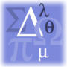
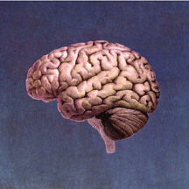
Intelligence
Direct
Expla- nation
Cognitive Architecture
Human Brain
(100 billion cells)
Notes:
Psychology: people with a high IQ have a high WM capacity

Slide 5
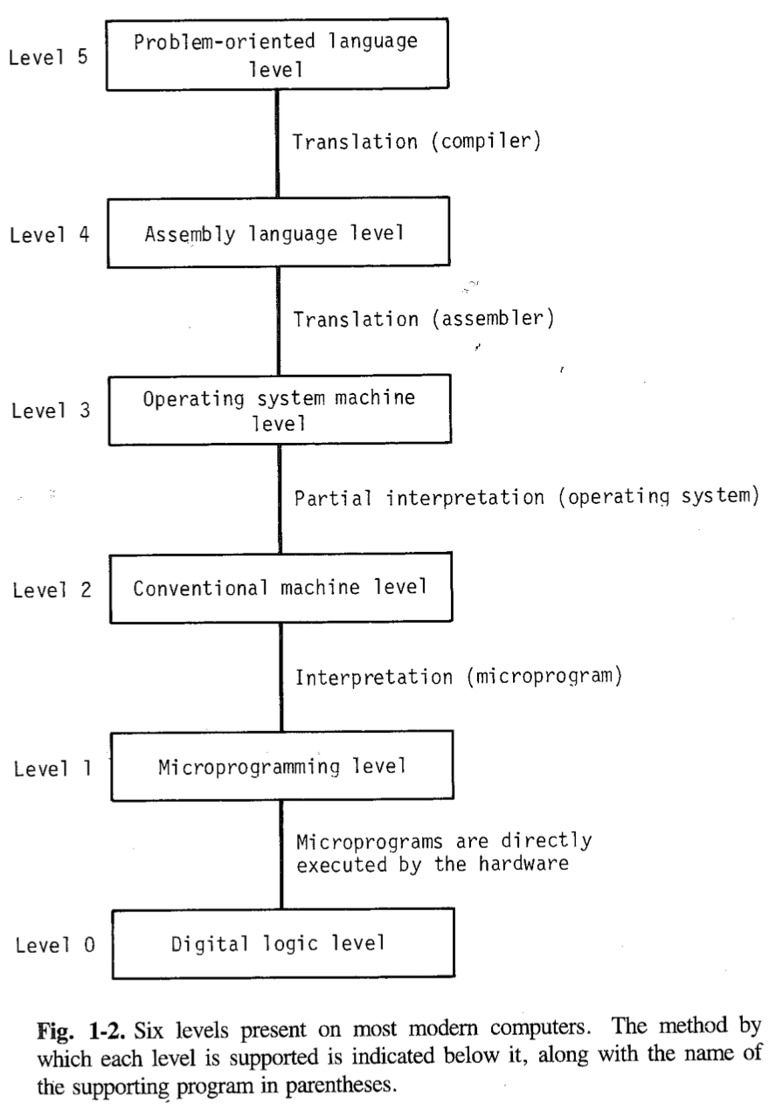
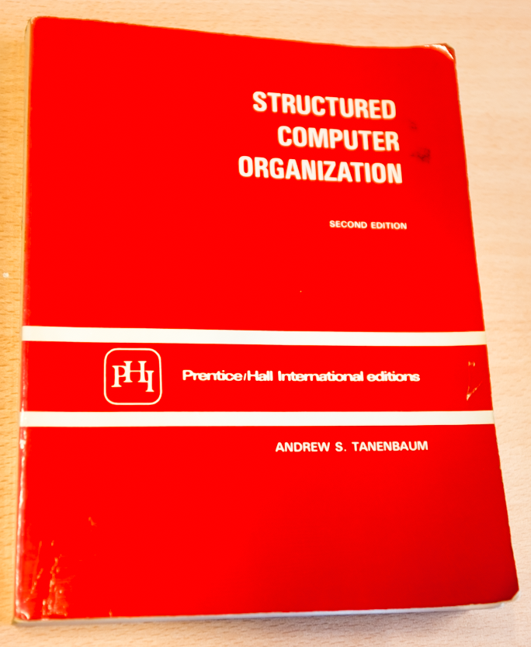
Notes:
Lower levels are physics, higher levels have “meaning”.

Slide 6
Levels of abstraction for Cognition (Newell)
Time Units | System | World theory
Months |  | Social Band
Weeks
Days
Hours | Task | Rational Band
10 min | Task
minutes | Task
10 sec | Unit Task | Cognitive Band
1 sec | Operations
100 msec | Deliberate act
10 msec | Neural circuit | Biological Band
1 msec | Neuron
100 μsec | Organelle

Slide 7
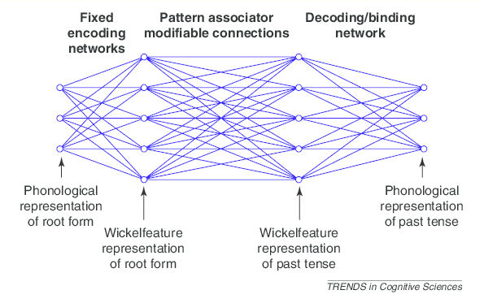
Operating at the wrong level

Slide 8
Production Rules/Operators

Slide 9
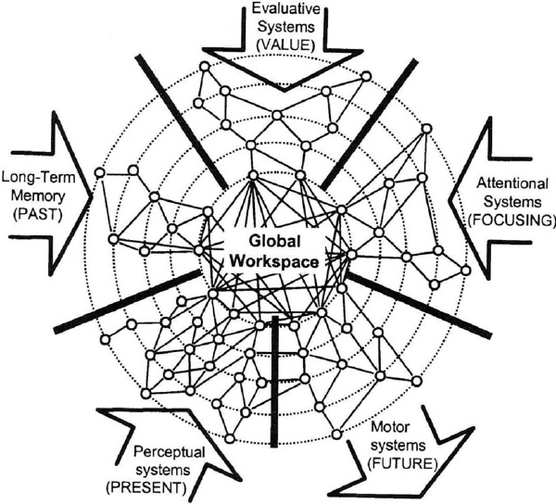
Assumption: Modular structure with a Global Workspace (Baars & Dehaene)

Slide 10
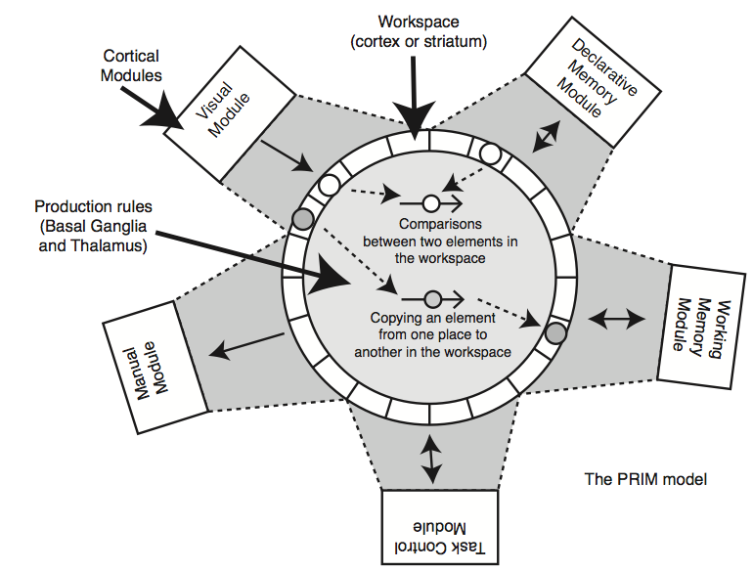
Our version

Slide 11
The neuron level
Cognitive modules are all over the brain (mainly cortex)
They each contribute to the workspace (the interface area, we will call those buffers)
Operations within the workspace are carried out by the Basal Ganglia

Slide 12
Cortical Area: Perception
Cortical Area: Memory
Cortical Area: Action
Basal Ganglia
Thalamus

Slide 13
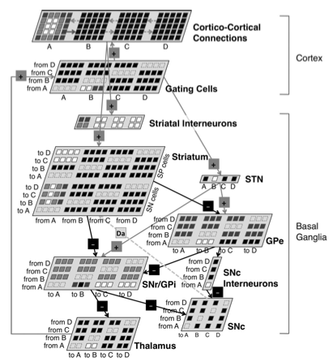
Andrea Stocco’s model of the Basal Ganglia

Slide 14
But what does it do?
Cortex
Visual
LTM
WM
Control
Manual
...
...
Basal Ganglia
Thalamus

Slide 15
Example: Aural-Vocal task
You hear a tone with a certain pitch (low-medium-high)
You have to say as quickly as possible the word associated with that pitch
Low -> One
Medium -> Two
High -> Three

Slide 16
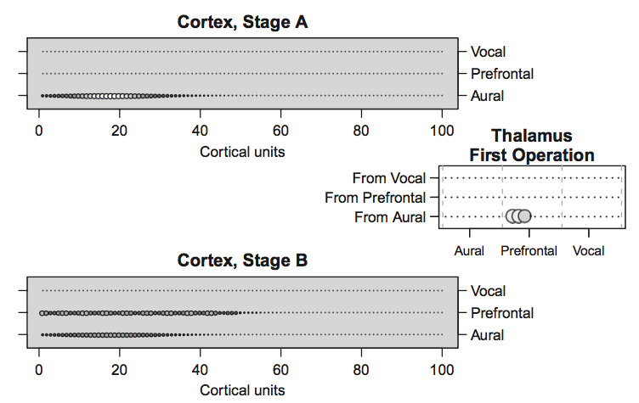

Slide 17
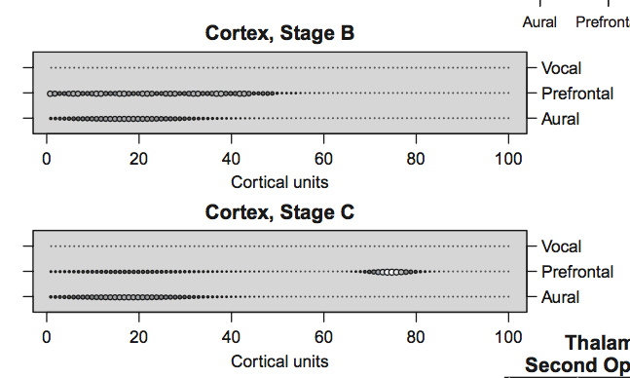

Slide 18
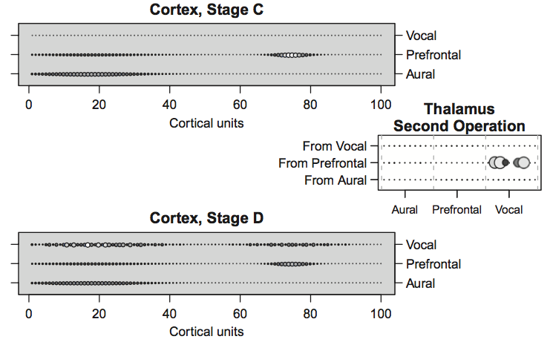

Slide 19
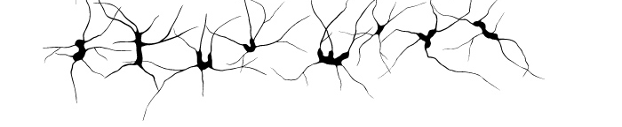
Stocco’s BG model: a lot of machinery for something simple
Neurons
“transistors”
PRIMs
“microprogramming”

Slide 20
Cortex
Visual
LTM
WM
Control
Action
...
...
Basal Ganglia
Thalamus
V2 = RT1
RT2 -> AC3

Slide 21
Let us look at the Aural-Vocal task again
Input
LTM
WM
Control
Action
Low Pitch
V1 <> nil
V1 -> RT2
Associate
Associate -> RT1
“One”
Say
RT3 <> nil
RT3 -> AC2
Say -> AC1

Slide 22
From PRIMs to operators
PRIMs
“microprogramming”
Operators
“machine language”
Complex tasks require many elementary steps that are carried out in parallel and in sequence

Slide 23
Aural-Vocal task has two operators
V1 <> nil
V1 -> RT2
RT3 <> nil
RT3 -> AC2
Associate -> RT1
Say -> AC1

Slide 24
Preview
How to build PRIMs models
Transfer in Text Editors
Explaining mental training
Skill-based approach
Bottom-up learning: learning from scratch
Neural network (Nengo) version of PRIMs

Slide 25
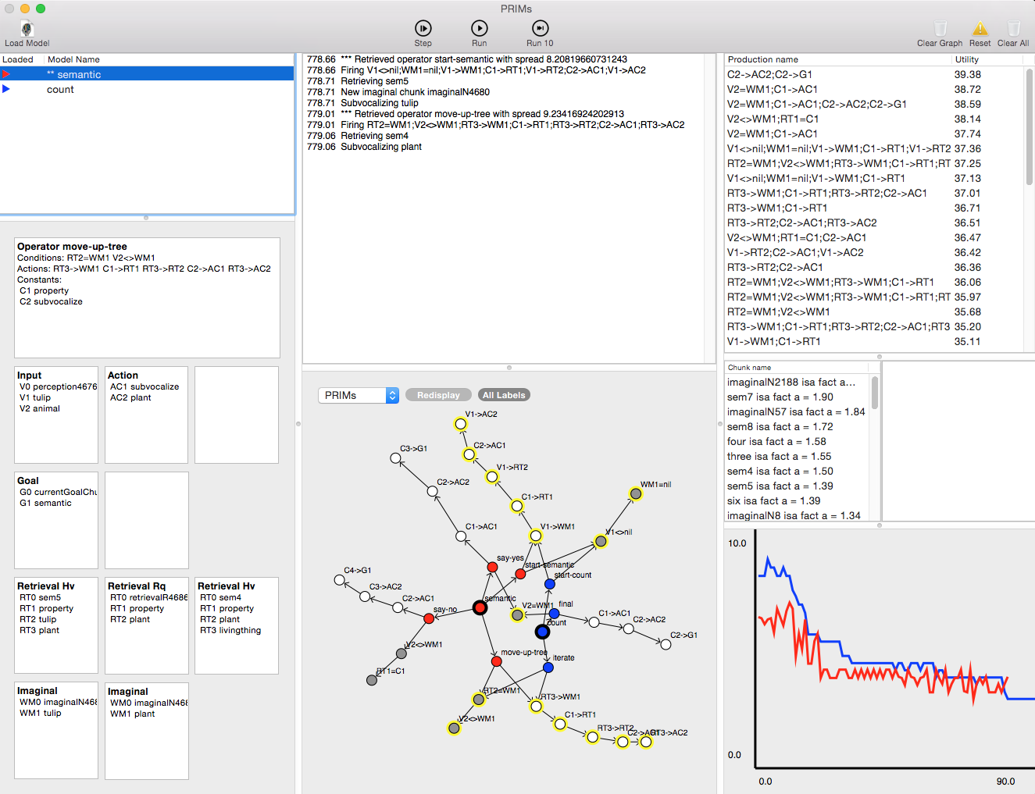
New implementation

